Slide 1
Lab 2

Slide 2
Write a Program (C++\Java\Python) to implement student semester registration process using iterative waterfall model and test the program.

Slide 3
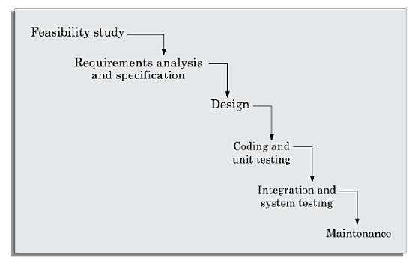
Classical Waterfall Model

Slide 4
Phase entry and exit criteria
A good SDLC besides clearly identifying the different phases in the life cycle, should unambiguously define the entry and exit criteria for each phase.
The phase entry (or exit) criteria is usually expressed as a set of conditions that needs to be satisfied for the phase to start (or to complete).
As an example, the phase exit criteria for the software requirements specification phase, can be that the software requirements specification (SRS) document is ready, has been reviewed internally, and has been reviewed and approved by the customer. Only after these criteria are satisfied, the next phase can start.

Slide 5
Shortcomings of the classical waterfall model
No feedback paths
Difficult to accommodate change requests
Inefficient error corrections
No overlapping of phases

Slide 6
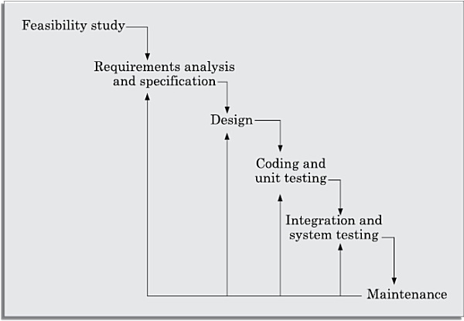
Iterative Waterfall Model
Phase containment of errors
Phase overlap
Blocking state
Feedback path

Slide 7
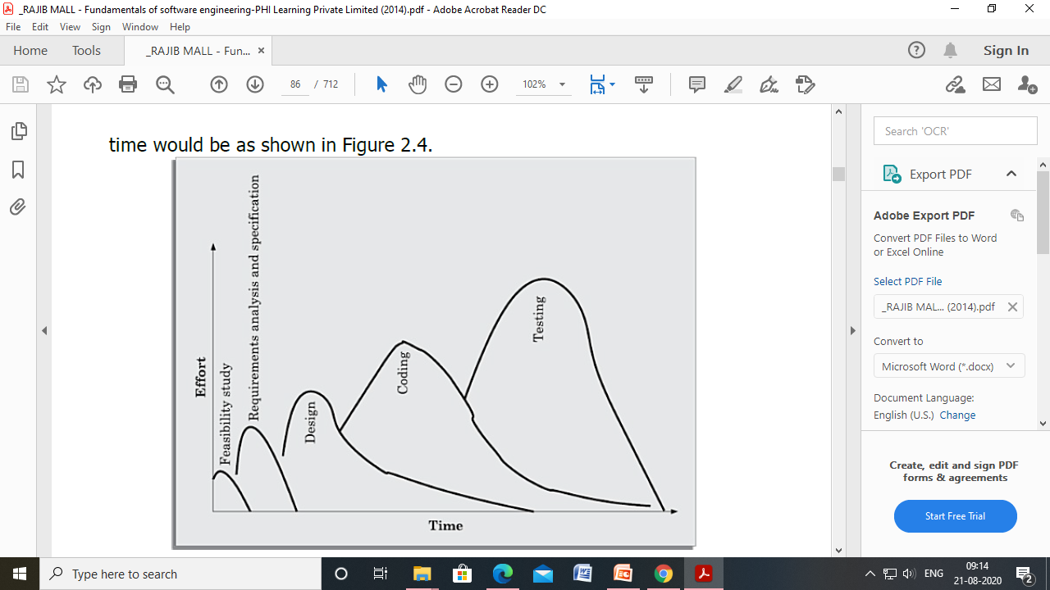
Iterative Waterfall Model

Slide 8
Shortcomings of Iterative Waterfall Model
Difficult to accommodate change requests
Incremental delivery not supported
Phases overlap not supported
Error correction unduly expensive
Limited customer interactions
Heavy weight
No support for risk handling and code reuse

